Slide 1

Coding and Computational
Thinking in the
Elementary Classroom
Alyson Hooker, Science Coach
Tracy Miller, Magnet Teacher Resource Specialist Trainer
Glenda Montgomery, First Grade Teacher
Andrew Silbaugh, Gifted/Fabrication Lab/ITV teacher

Slide 2
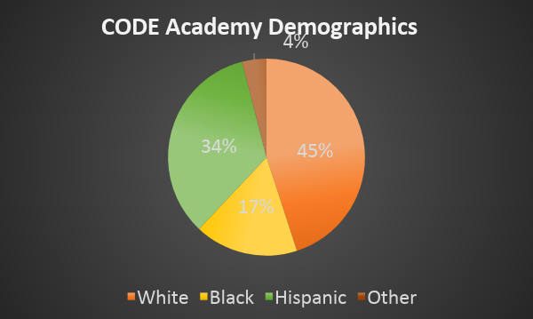
Who We Are…
Title I- PK-5
High Poverty Area
Our Community
  21.8%-26.6% below poverty
  $12,060/individual
  $24,600/family of four
80% Economically Disadvantaged
15% ELL
Grade has risen from F to C

Slide 3
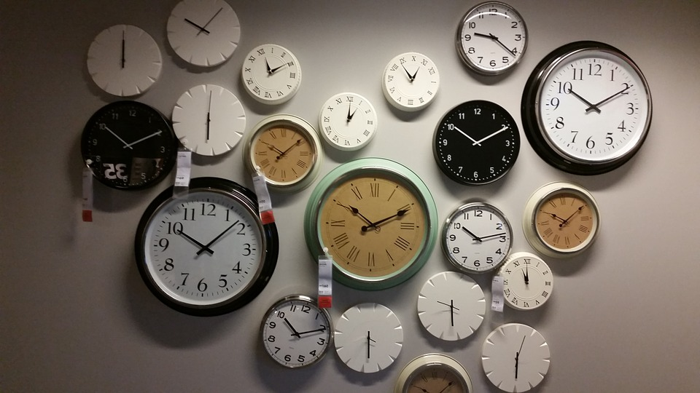
Our Classroom Time
120 minutes - ELA
90 minutes - math
20 minutes - recess
50 minutes - specials
25 minutes - lunch
60 minutes - power hour
_______________________
6 hours and 5 minutes
That leaves 55 minutes for transitions across campus, science, social studies, STEM

Slide 4
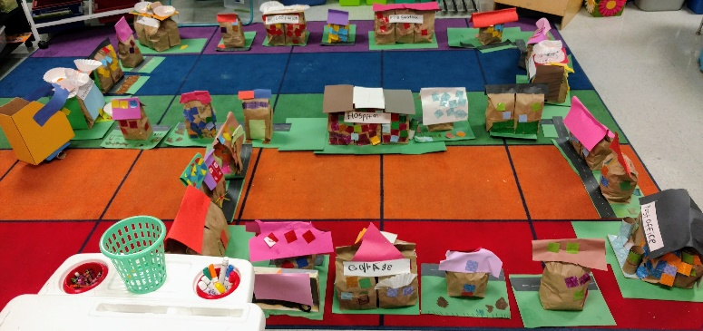
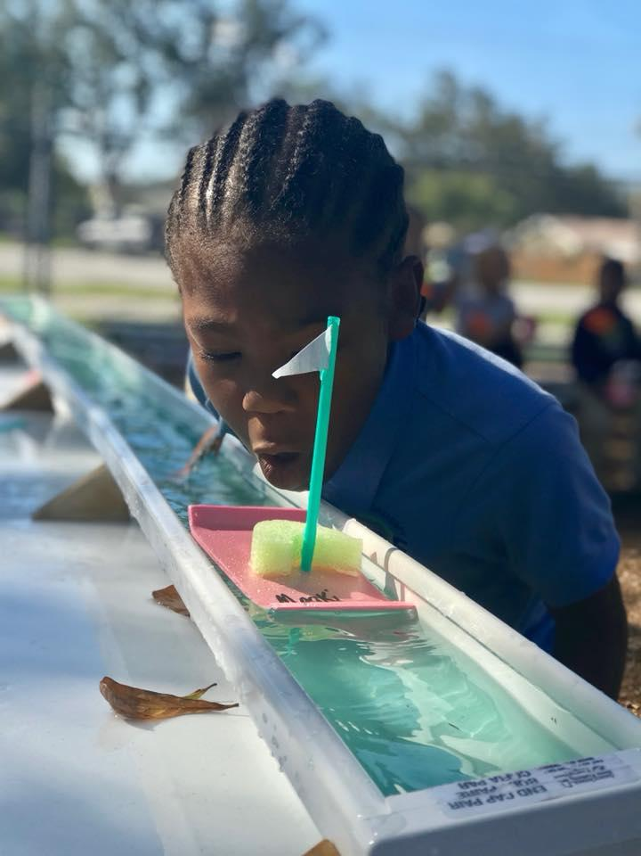
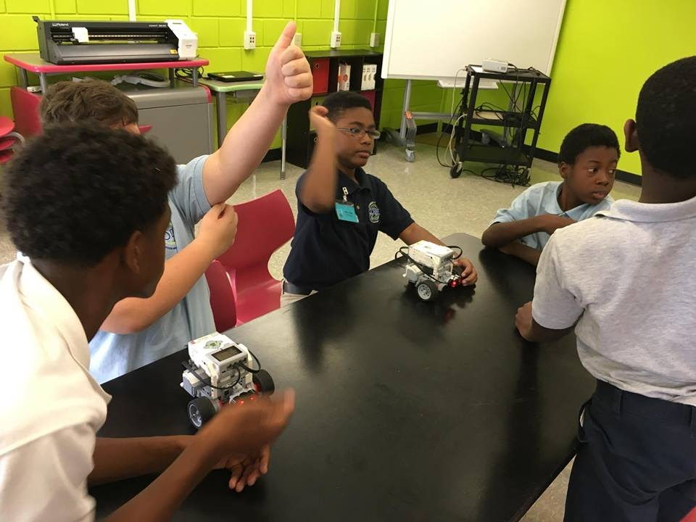
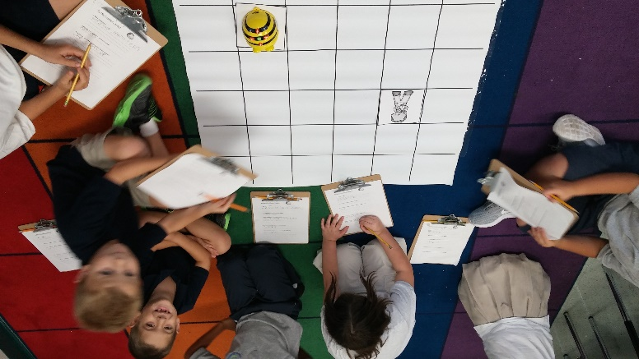
That Does Not
Stop Us…

Slide 5

How We Make
the Difference
Units of Study/PBL
Cross-discipline activities
Science Lab/STEM Lab/FAB Lab
Free After School Clubs (robotics, coding, television, etc.)
Engineering Design Process/Scientific Method
Student Collaboration
Student Reflection/Revision

Slide 6
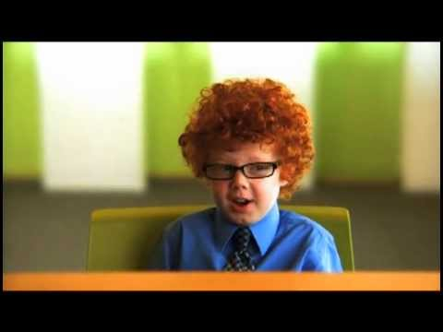
The Interview

Slide 7
Employers are looking for 21st century skills
Collaboration, Communication, Creativity, Critical Thinking
But Why STEM?
Skill/Quality | Weighted average rating (5 point scale)
Ability to verbally communicate with persons inside and outside the organization | 4.63
Ability to work in a team structure | 4.62
Ability to make decisions and solve problems | 4.49
Ability to plan, organize and prioritize work | 4.41
Ability to obtain and process information | 4.34
Ability to analyze quantitative data | 4.21
Source: National Association of Colleges and Employers, Jobs Outlook 2016

Slide 8
Computational
Thinking
Break a problem into parts or steps (decomposition)
Recognize and find patterns or trends (pattern recognition)
Develop instructions to solve a problem or task (algorithmic thinking)
Generalize patterns to develop rules (abstraction - taking out details that are not important )
Computational thinking is not coding, however computational thinking helps students solve problems (like coding challenges)

Slide 9
Computational Thinking
in the Disciplines
Computational Thinking | Subject Area
Break a problem into parts or steps | Reading/Writing: Ability to communicate thoughts in an organized, structured, logical way. Decompose story into smaller chunks for storytelling Create a plan for writing
Develop instructions to solve a problem or task | Social Studies : Create a set of instructions that will navigate a person to a specific location, use cardinal directions.
Generalize patterns to develop rules | Math: Navigate on the coordinate plane Use variables to represent objects Develop a formula to find area and perimeter

Slide 10
Our goal: Provide opportunities for students to “debug” their own thinking
K-2
Visual, block-based programming -
removes barriers created by syntax errors found in text based programming
3-5
Visual transitioning to Text-based -
requires more critical thinking and uses proper sequencing and creativity
Code.org pre-reader + unplugged activities
Bee-Bots (no computer needed)
Osmo (iPad)
Hello Ruby & CAS Barefoot
Dash and Dot robots
Dash and Dot robots (iPad)
Bee-Bots (no computer needed)
Scratch Jr. (computer)
Scratch (computer)
Kodable

Slide 11
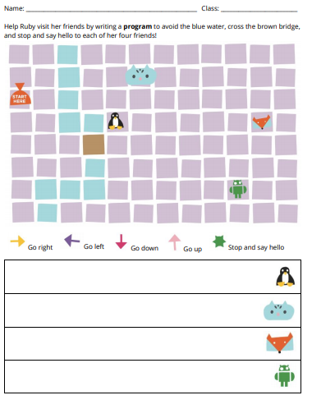
Unplugged
Let’s do a quick “unplugged” activity based on the characters in the book
Hello Ruby

Slide 12
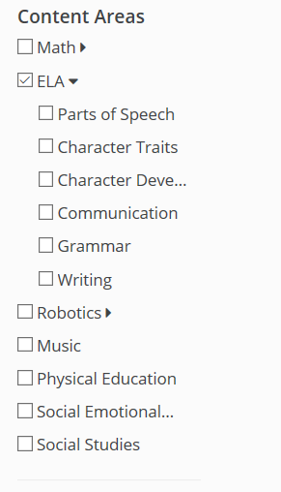
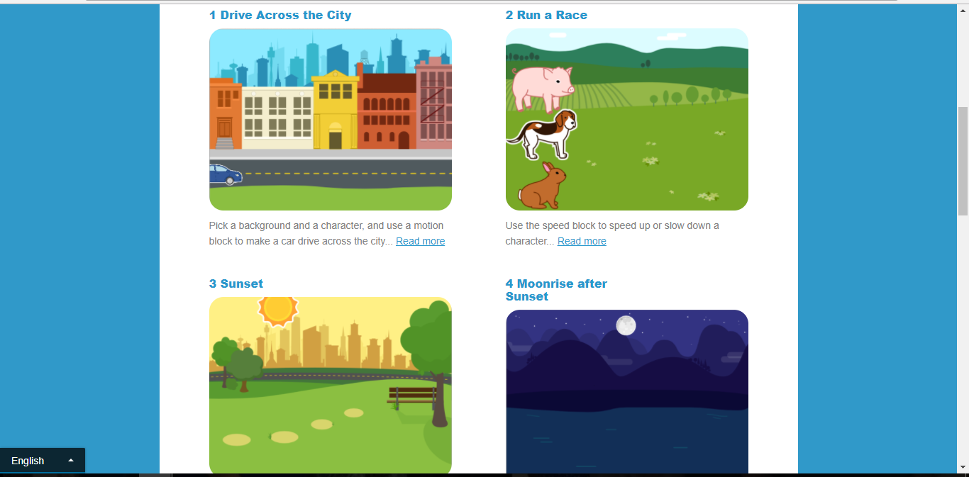
Girls Who Code, Jr.
Grades 3-5
Kodable
Basics of Coding through games
Scratch, Jr.
Tutorials

Slide 13
Utilizing Scratch
with Gifted Students
Scratch can be simple
However, simple to us, is not always simple to students
Books “Coding with Scratch” and “Coding in Scratch: Projects”
  Students complete the steps and exercises
  Students complete the challenge questions
  Students show work
  Students move onto next topic
Goal: Create students who feel confident in using Scratch

Slide 14
Scratch Process
Basic Exercises
  Master the basics
  Learn Scratch from the start
Advanced Projects
  Multistep processes
  More dynamic projects
Self Choice
  Student creates a project on their own
  Guidance and Support

Slide 15
But What About
Computational Thinking?
Task | Scratch Process
Decomposition | -Step Order -Play steps out in head/paper/self -What am I being asked?
Pattern Recognition | -Are the steps in order? -Is there a pattern? -What happens if I use a repeat/loop
Abstraction | -What blocks will do nothing? -What blocks will give me a problem? -What is my roadblock?

Slide 16
But Most Importantly
Task Definition
Showcase
Think through process
Skill Mastery
Develop Skills

Slide 17

Edmodo
Resources, PowerPoint, and More from us
Group Code: y69xnr

Slide 18
Interactive Playground
Beebots/Osmo- Tracy
Dash Basketball Challenge- Alyson
Scratch/Kodable- Glenda
Raspberry Pi/HTML Unplugged- Andrew

