Slide 1
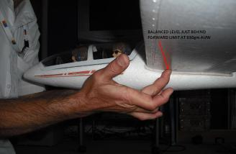
Balance
Perhaps the most common problem that prevents gliders in this competition from flying well is that they are too tail heavy
Balance glider on finger tips
Place a finger under each wing, around ¼ of the way back along the wing
If the glider is at least close to balancing, it is worth test flying
If the glider is noticeably nose heavy or tail heavy, it will NOT fly well

Slide 2
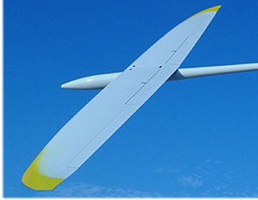
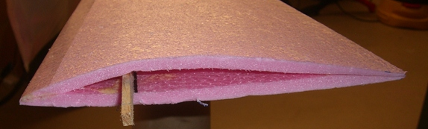
Wing Shape
Straight wing= Good idea (glides well)
Aerodynamic shape= Good idea (gives lift but not too much drag)

Slide 3
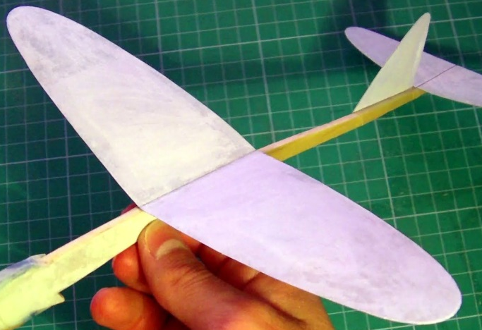
Wing Shape
Rectangular foam block= Bad idea
(bad aerodynamics, lots of drag)
Poster board or paper wing= Bad idea (too flimsy)
Swept wing= Bad idea (does not glide as well as a straight wing)

Slide 4
Tail Sizes
Horizontal tail should be at least 1/5 the size of the wing (or bigger)
Vertical tail should be at least 1/10 the size of the wing (or bigger)
If tail surfaces are too small, they cannot stabilize the glider
If tail is too heavy, the glider will not fly
Vertical tail
Tail is lightweight,
which helps keep the airplane
from being too tail heavy
Horizontal tail

Slide 5
Additional Info
Test fly the glider A LOT. Make sure it flies well time after time.
Just to give you a feel for performance, the first, second, and third place winners in this competition can usually glide at least 30 feet each flight, sometimes more
*Slides created by Louis Turek

