Slide 1
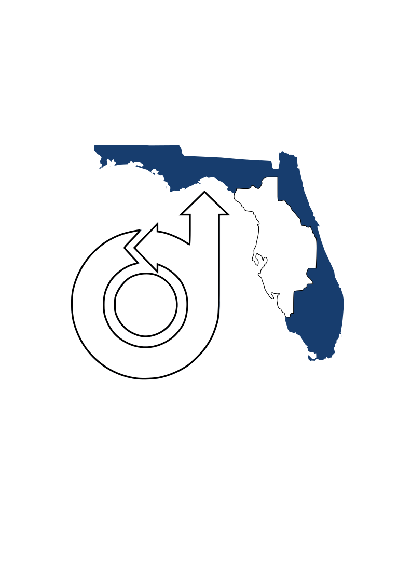
Glider Workshop
UCF SECME Glider Competition 2023-2024
Chris Stevens, Dr. Michael Kinzel

Slide 2
What Makes a Good Glider?
What makes a good glider?
Wing Shape
The Importance of a Tail
Balance
Competition Rules

Slide 3
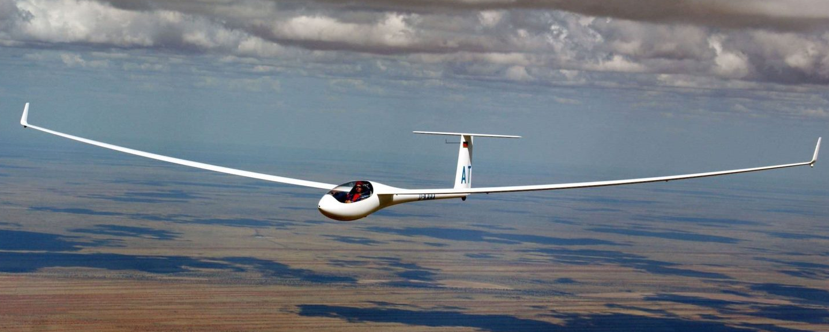
Wing Design
Long, Thin Wings
Length/Chord ratio >6
Maximum Lift/Drag in slow flight
Wing Span
Wing Chord
Wing Length
Smooth, Thin Airfoil Shape
Essential for good gliding performance

Slide 4
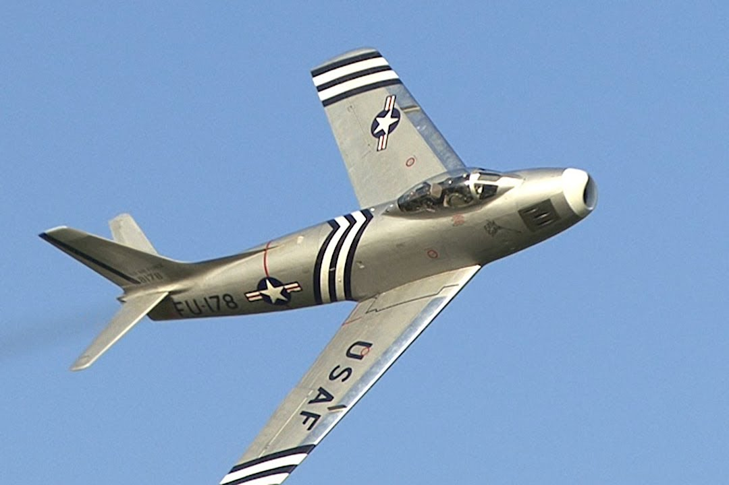
Wing Design
Swept Wings, Bad Idea for Gliders
Doesn’t help at low speeds
Makes structure difficult/heavy
Dihedral Angle
Stabilizes straight forward flight
Slightly decreases lift
Can be polyhedral (flat and angled)

Slide 5
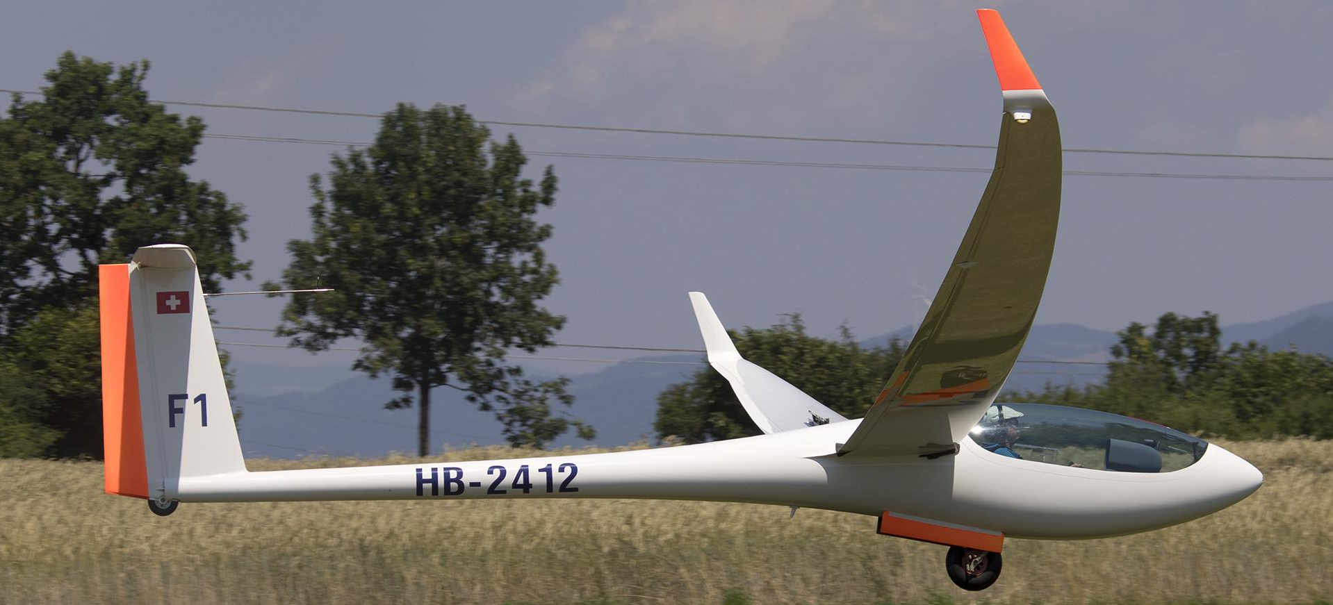
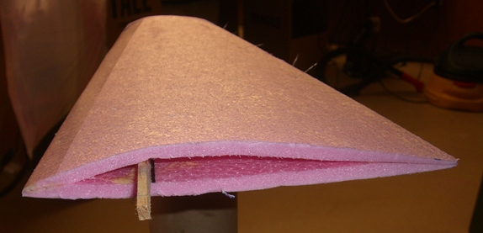
Wing Structure
Wings must be strong enough
Light, but strong design
The more bend, the less lift
Leading (front) Edge
Example wing structure
Folded material with spar
Trailing (back) Edge
Spar (structural support)

Slide 6
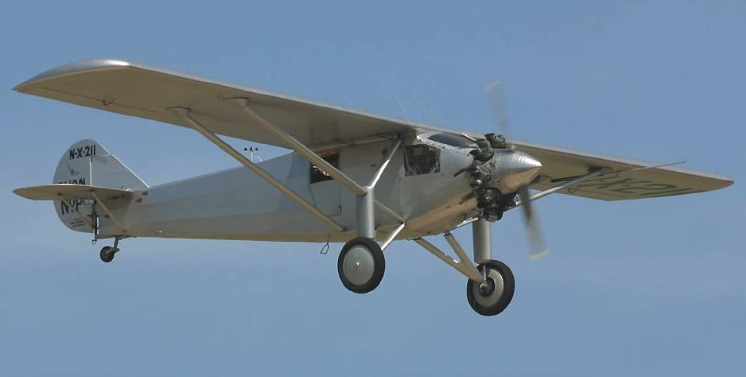
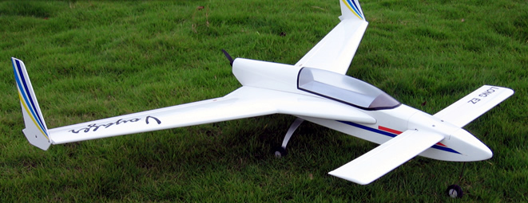
Tail Design
Vertical Stabilizer
Tail is critical for stability
Horizontal Stabilizer
At least 1/5 area of wings
Vertical Stabilizer
At least 1/10 area of wings
Fuselage Length
4-6x wing chord length
If too short, won’t be stable
Chord Length
Horizontal Stabilizer
Fuselage Length
Canards and Flying Wings
More efficient
Almost always unstable

Slide 7
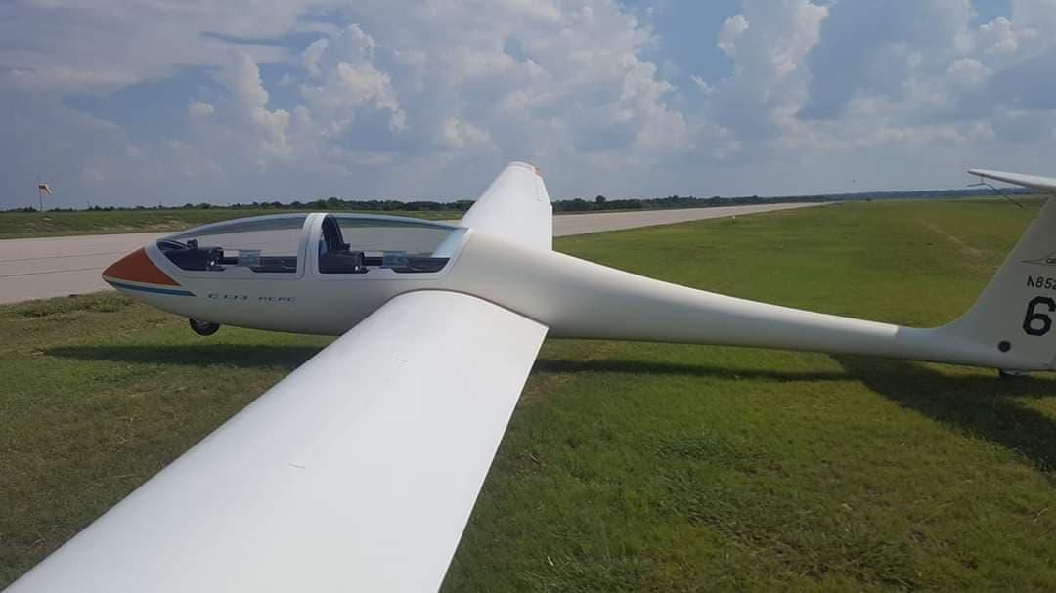
Forces on a glider
Lift
Thrust?
Drag
Lift
Gravity
Drag
Stabilizer Lift
Gravity

Slide 8
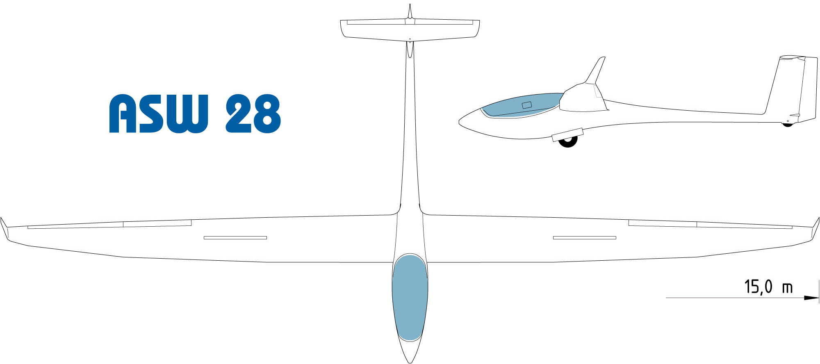
Balance
Most important, Center of Gravity (with marbles) in front of Center of Lift
Center of Gravity (where you balance the weight)
Center of lift (center of the wing and horz tail)
CG too far forward flies poorly, CG too far back flies once
Body length should be close to wingspan
Back section 4-6x Wing Cord Length
Long (3/4 of body length)
Wingspan
Center of Lift, at ~1/4 cord length
Center of Gravity (balance point)
Short (1/4 of body length)

Slide 9
Wrap-Up
Long, thin wings. Strong enough to hold up
Tail Surfaces
Far enough back, big enough to keep the plane stable
Lightweight
Balance
Center of Gravity (where you balance the weight) before Center of lift (center of the wing and horz tail)

Slide 10
Rules Review
Minimum 24in Wingspan, no max
Maximum 4x4 Body Width, any length
Must carry 16 marbles in sealed sandwich bag, 2.1oz
Weight between 8oz and 12oz (including marbles)
Total of 4 flights, score is total distance glided
If glider breaks, score reduced by 25%
No designs/parts from kits, no metals/hard materials for safety

Slide 11
Suggestions
Hobby/craft stores have balsa wood, foam board, monokote/ultracoat
Dollar Tree is good place for foam board (~$1)
Leading edge balsa wood is great
You can build small balsa gliders for practice
Don’t waste material/weight on unnecessary things

Slide 12
Wrap-Up
Good luck!
If you have any questions, you can contact us at AIAA.Central.FL@gmail.com

