Slide 1
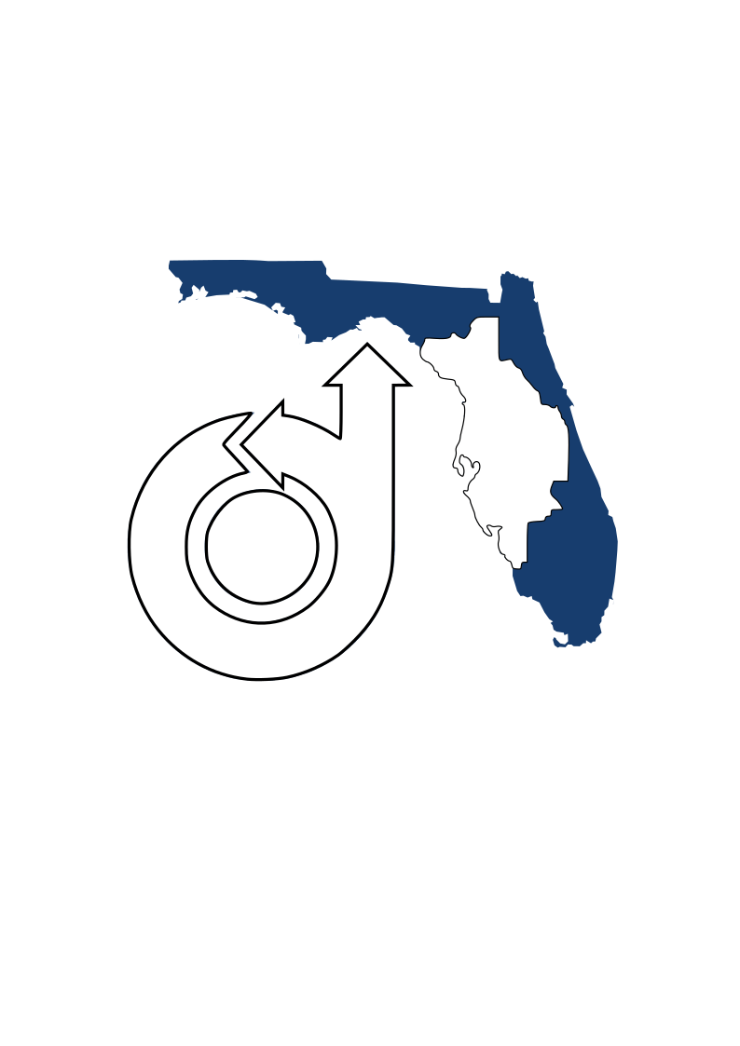

Glider Workshop
UCF MISSION: STEM Glider Competition 2024-2025
Rhett Jefferies, PhD

Slide 2
What Makes a Good Glider?
What makes a good glider?
Wing Design
The Importance of a Tail
Balance
Competition Rules

Slide 3
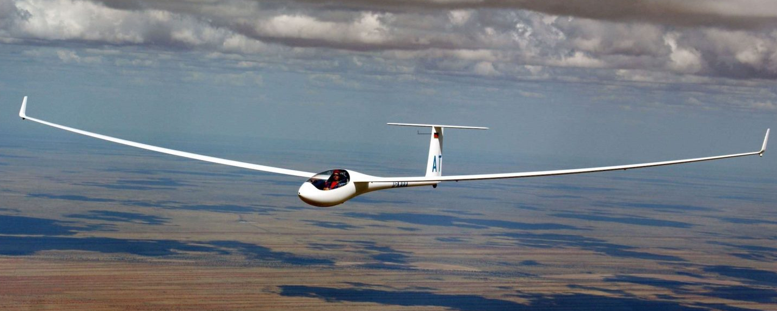
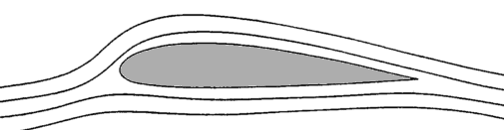
Wing Design
Long, Thin Wings
Length/Cord ratio >6
Maximum Lift/Drag in slow flight
Wing Camber
Wing Length
Smooth, Thin Airfoil Shape
Essential for good gliding performance
Wing Chord

Slide 4
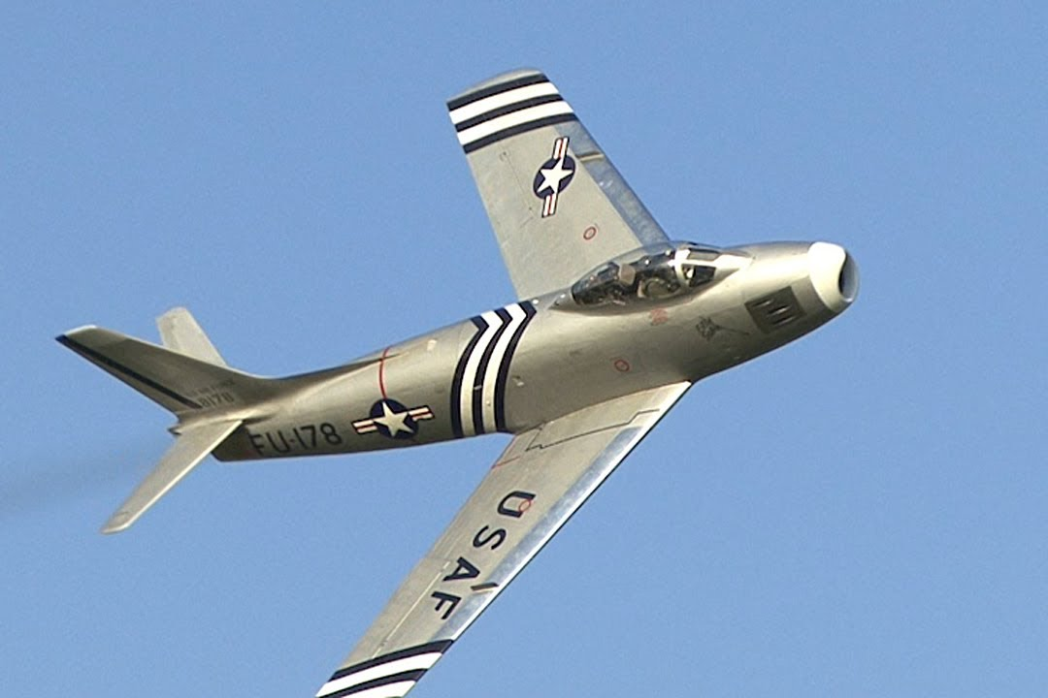
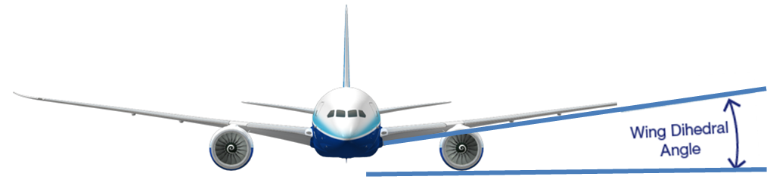
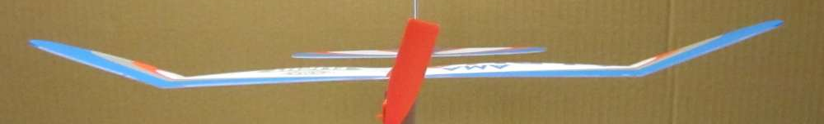
Wing Design
Swept Wings, Bad Idea for Gliders
Doesn’t help at low speeds
Makes structure difficult/heavy
Wing Span
Dihedral Angle
Stabilizes straight forward flight
Slightly decreases lift
Can be polyhedral (flat and angled)

Slide 5
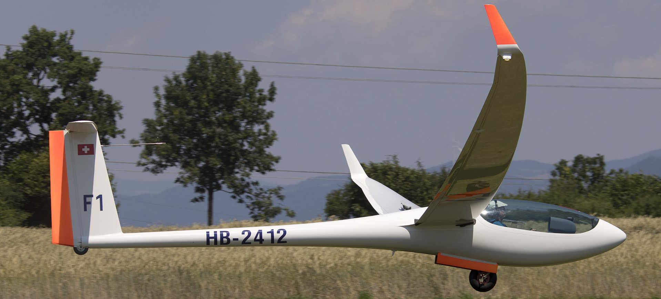
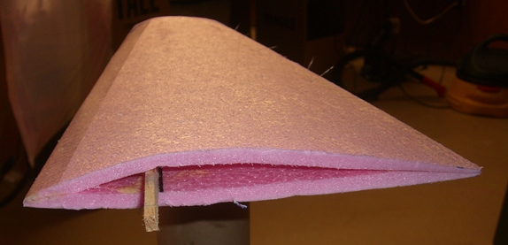
Wing Design
Wing Structure
Light, but strong design
The more bend, the less lift
Leading (front) Edge
Example wing structure
Folded material with spar
Trailing (back) Edge
Spar (structural support)

Slide 6
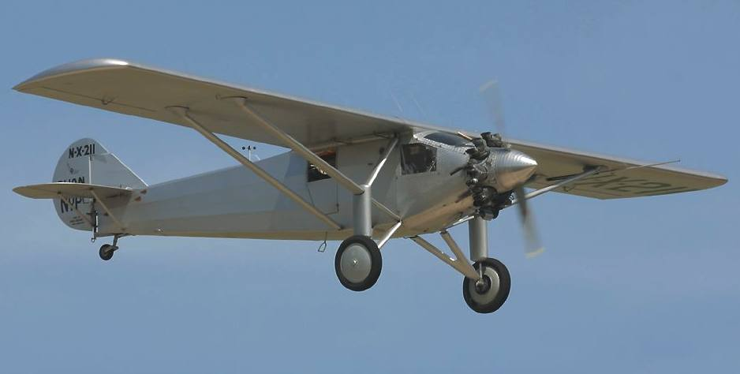
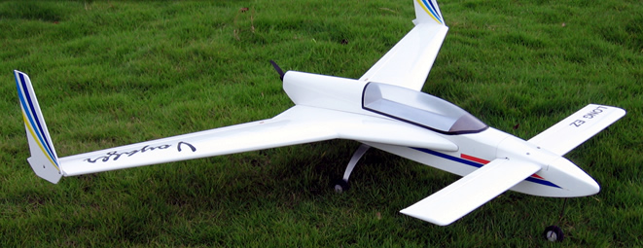
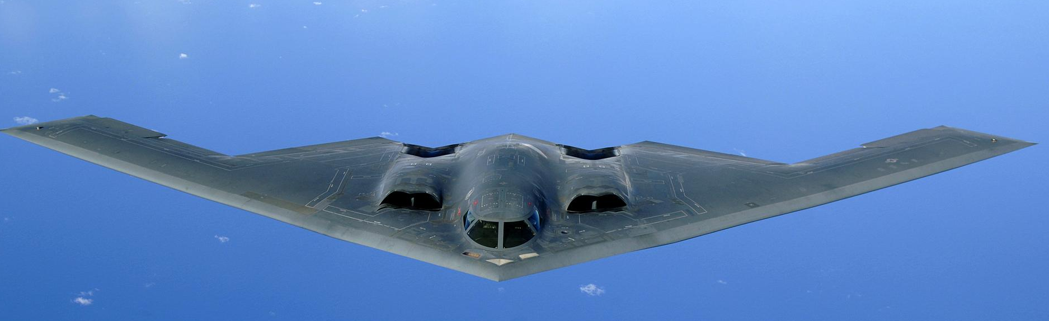
Tail Design
Tail is critical for stability
Horizontal Stabilizer
At least 1/5 area of wings
Vertical Stabilizer
At least 1/10 area of wings
Fuselage Length
4-6x wing chord length
If too short, won’t be stable
Vertical Stabilizer
Cord Length
Horizontal Stabilizer
Fuselage Length
Canards & Flying Wings
More efficient
Almost always unstable

Slide 7
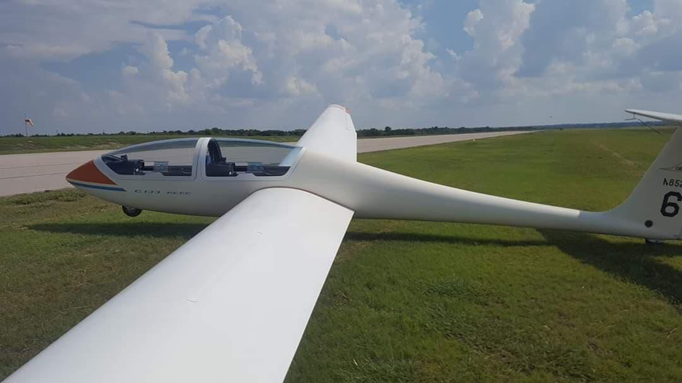
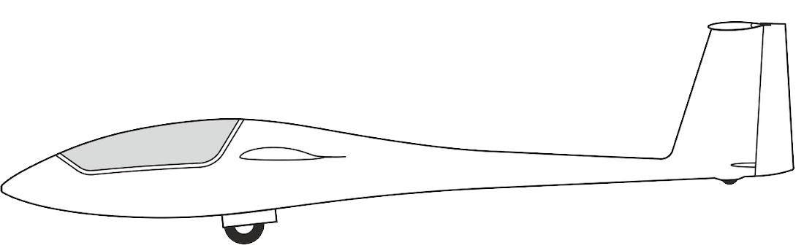
Forces on a glider
Lift
Thrust?
Drag
Lift
Gravity
Drag
Stabilizer Lift
Gravity

Slide 8
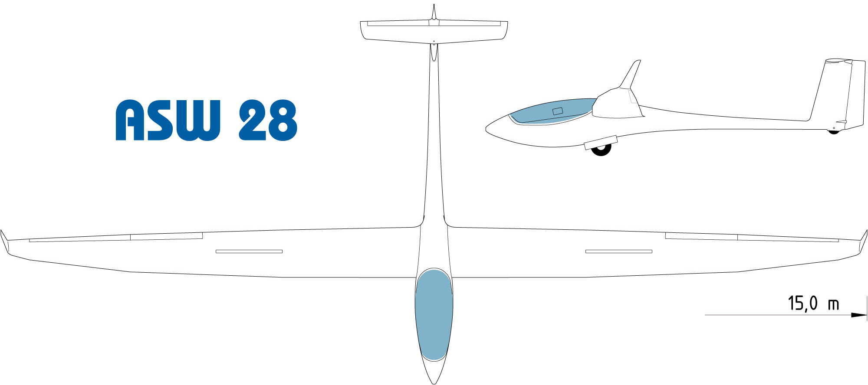
Glider Balance
Most important, Center of Gravity in front of Center of Lift
Center of Gravity (CG) too far forward flies poorly; CG too far back flies once
Fuselage (Body) length should be close to wing length
Long (3/4 of body length)
Wingspan
Center of Lift ~1/4 chord length
Center of Gravity (balance point)
Short (1/4 of body length)

Slide 9
Design Summary
Long, thin wings. Strong enough to hold up
Tail Surfaces
Far enough back, big enough to keep the plane stable
Lightweight
Balance
CG in front of center of lift

Slide 10
Competition Rules
Minimum 24in Wingspan, no max
Maximum 4x4 Body Width, any length
Must carry 16 marbles in sealed sandwich bag, 2.1oz
Weight between 8oz and 12oz (including marbles)
Total of 4 flights, score is total distance glided
Obstacle, 2x2 milk crates 26x26” at 15 ft.
If glider breaks or hits obstacle, score reduced by 25% for flight
No designs/parts from kits, no metals/hard materials for safety

Slide 11
Suggestions
Hobby/craft stores have balsa wood, foam board, monokote/ultracoat
Balsa wood for leading edge is great
Build a smaller version early to try out design & practice
Don’t waste material/weight on unnecessary things

Slide 12
Wrap-Up
Good luck!
If you have any questions, you can contact me
rhett.Jefferies@ucf.edu
321-945-0786

