Slide 1
ENERGY TRANSFER MACHINE (ETM)
Mission: STEM Teacher Workshop
September 13, 2025
Presented by:
Susan T. Schleith

Slide 2
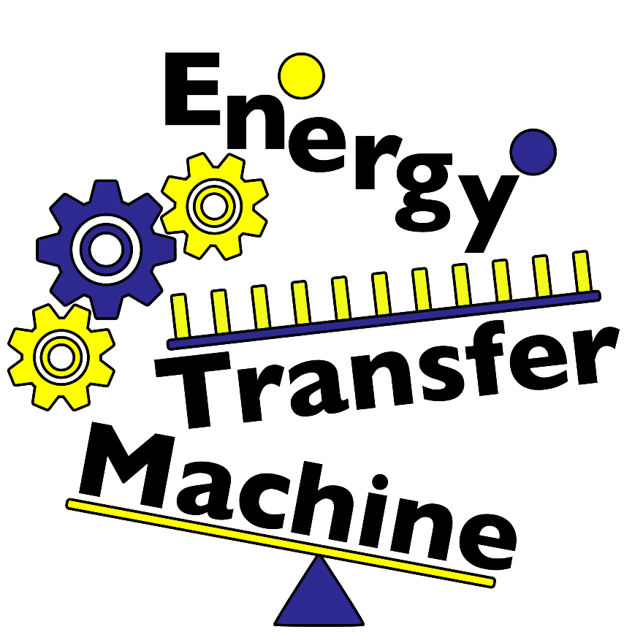
Overview
FSEC Background
Rube Goldberg & ETM
ETM Rules
How to Implement ETM
Hints & Tips
Resources
Notes:
We will be covering quite a bit of territory in this short presentation. We will offer a bit of information about FSEC and what we have available to teachers and schools. We will also talk a little history and the connection between Rube Goldberg and ETM. Then we will cover the ETM rules, how to implement a program and end with hints, tips and great resources.

Slide 3
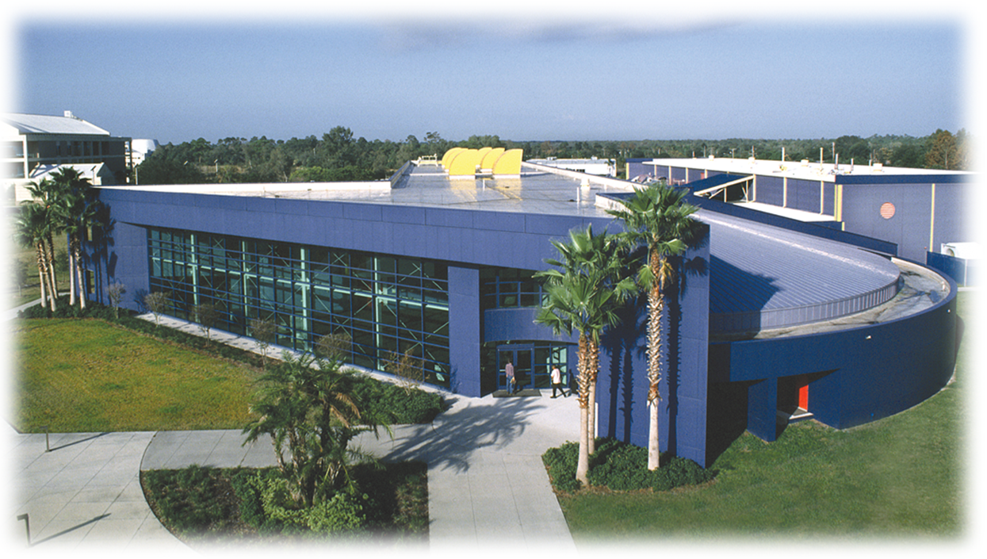
Florida Solar Energy Center® (FSEC®)

Slide 4
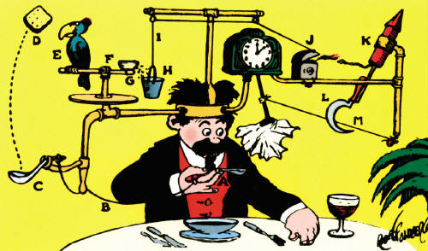
Rube Goldberg
(1883 – 1970)
Engineer, Inventor, Cartoonist

Slide 5
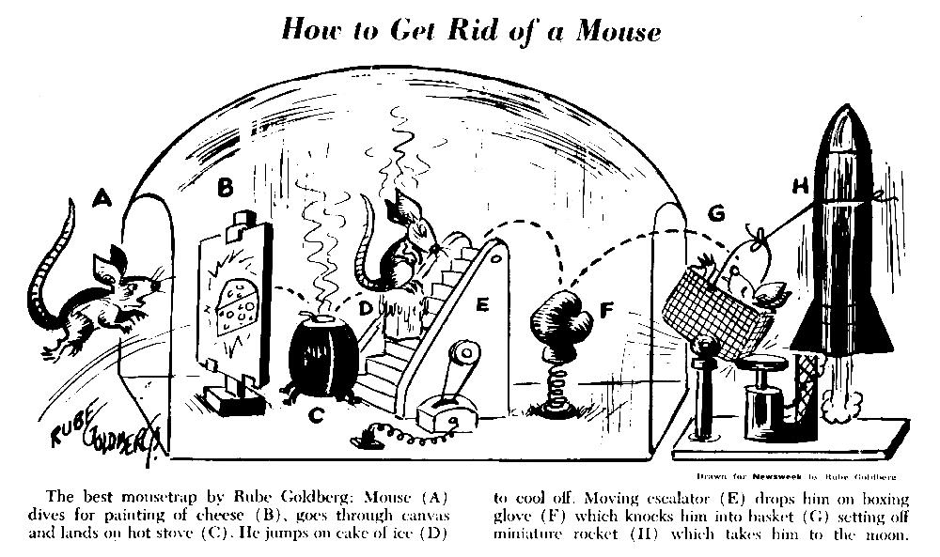
Rube Goldberg designs are meant to show the unnecessary complexities in machines

Slide 6
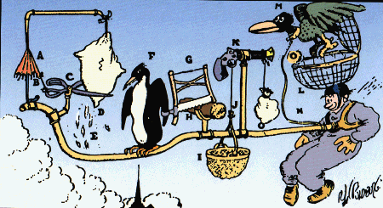
Webster’s definition of ‘Rube Goldberg’
A comically involved, complicated invention, laboriously contrived to perform a simple operation

Slide 7
How does your class turn off a light?
Insanity Kontraption

Slide 8
How to get started
Select --
An end goal
Size
Theme
Materials
Gather ideas (Check out this and this)
Make a rough plan!
Major components
Secondary components
Connectors

Slide 9
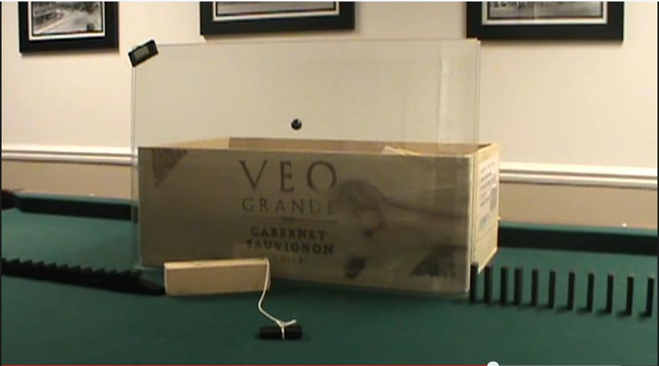
Major Components
Use large or unusual objects

Slide 10
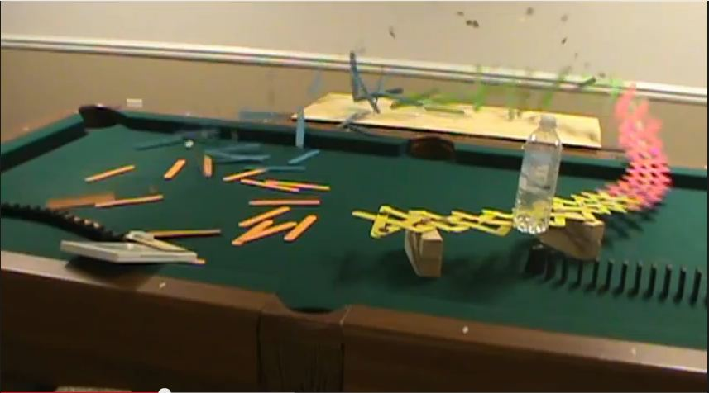
Major Components
Make it showy!

Slide 11
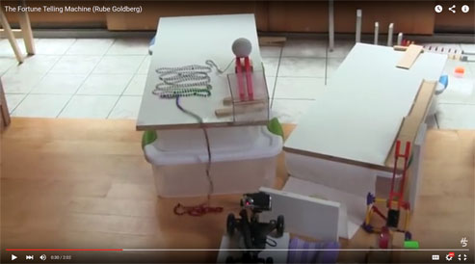
Secondary Components
Used between major components to make the machine longer

Slide 12
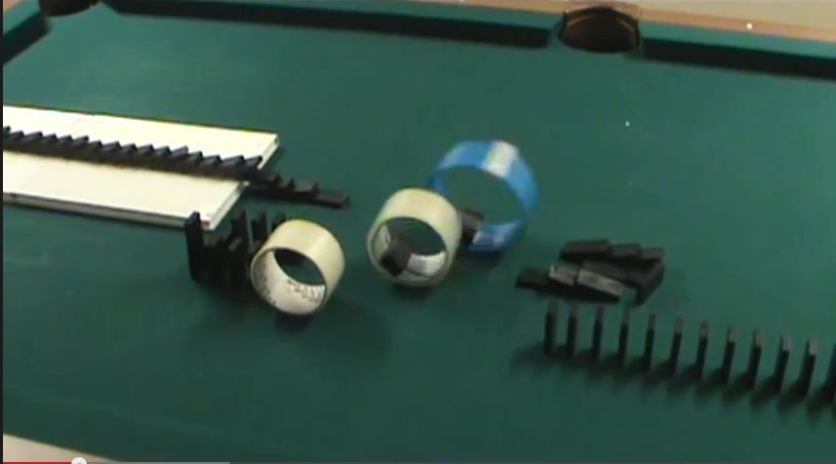
Secondary Components

Slide 13
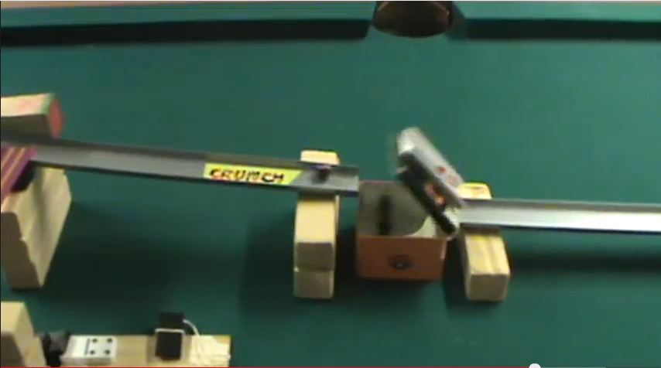
Secondary Components
And to show off your skill!

Slide 14
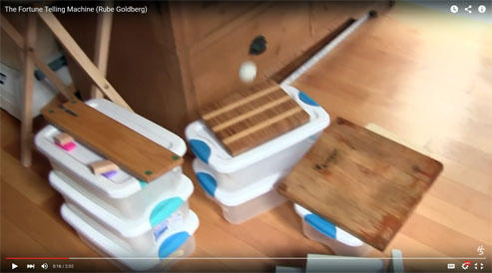
Secondary Components

Slide 15
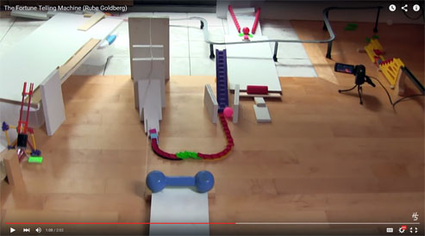
Connectors
Used between major and secondary components with things like dominoes, marble or popsicle stick ‘runs’

Slide 16
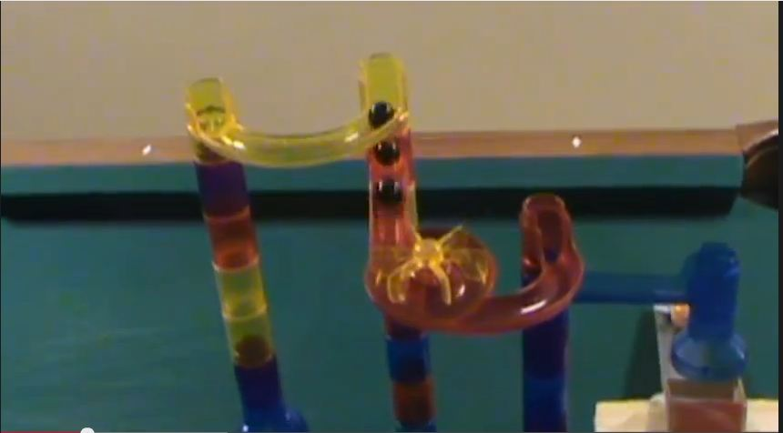
Connectors
Marble slides or other ready to use toys are also connectors, not major components

Slide 17
Building and Testing
Test each major and secondary component separately
Modify until they work at least 90% of the time
Link them together with connectors
Test and modify together (use safety gaps!)
Don’t get discouraged!
Good advice from other builders – here
Fasten parts (domino run ‘hinges’)
Clean up your design
Add thematic and artistic elements
Add humor!

Slide 18
Building and Testing
Test each major and secondary component separately
Modify until they work at least 90% of the time
Link them together with connectors
Test and modify (use safety gaps!)
Don’t get discouraged!
Fasten parts (domino run ‘hinges’)
Clean up your design
Add thematic and artistic elements
Add humor!

Slide 19
Lights, Camera, Action!
Start planning early how to shoot the video
Team introduction and machine explanation may be edited
Machine run must be shot in one continuous recording
Plan where camera operator will stand & move to get a clear shot of the action
Note--none of the previous videos were done in ‘one shot’ – it is not as easy as it seems!

Slide 20
Energy Transfer Machine Rules
The machine shall:
Have a minimum of 5 steps (hopefully many more!)
Perform a team specified event at the 1 minute mark (or as close as you can get!)
At least one step will use the electricity from a battery that does not exceed 9 volts.
Be videotaped to show its performance from start to finish

Slide 21
Energy Transfer Machine Rules
The machine cannot:
use any actual timing devices
be designed, assembled or fabricated by anyone other than student team members
use animals, profanity, hazardous materials, flames, explosives, etc.

Slide 22
Energy Transfer Machine Rules
The team:
must all contribute to building the machine
may not use non-team members in video or audio
Note: Assisting the machine during the run will result in a deduction of points. However, it is better to ‘nudge’ the machine than submit an incomplete run.

Slide 23
Winning Tips
Psst…….here’s the secrets!

Slide 24
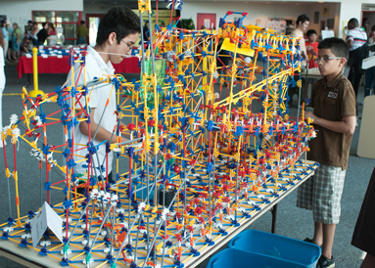
Make it interesting
Too much of a ‘good’ thing

Slide 25
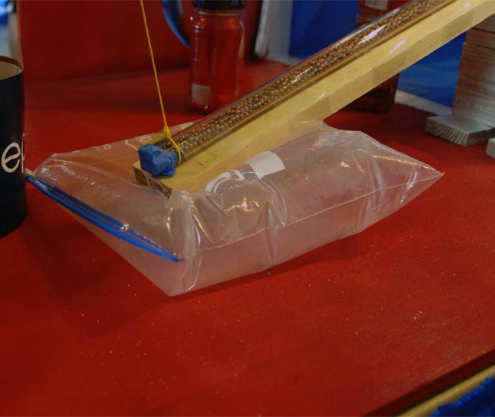
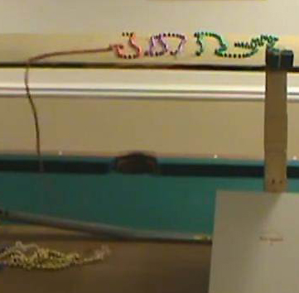
Make it go for 1 minute
Use a ‘slower’ transfer

Slide 26
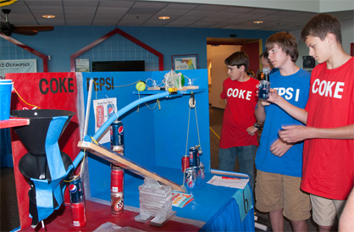
Have a theme; add humor
Coke vs. Pepsi

Slide 27
Thank You!

