Slide 1
Glider Workshop
UCF MISSION: STEM Glider Competition 2026-2027
Rhett Jefferies, PhD
Chair, AIAA Central Florida Section
American Institute of Aeronautics and Astronautics

Slide 2
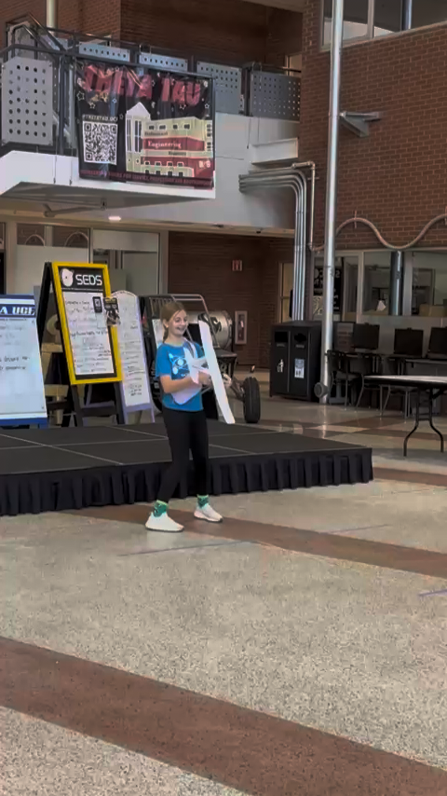
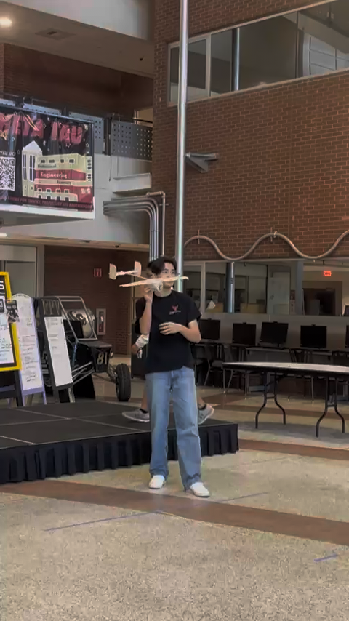
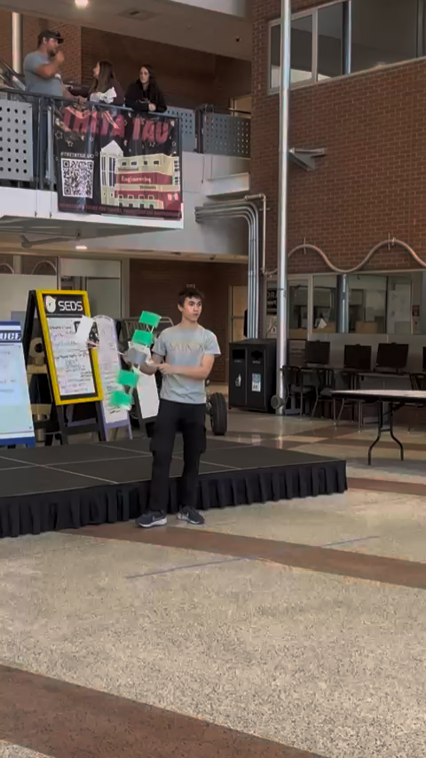
AIAA Glider Competition – Feb 2026

Slide 3
What Makes a Good Glider?
What makes a good glider?
  Wing Design
  The Importance of a Tail
  Balance
Competition Rules

Slide 4
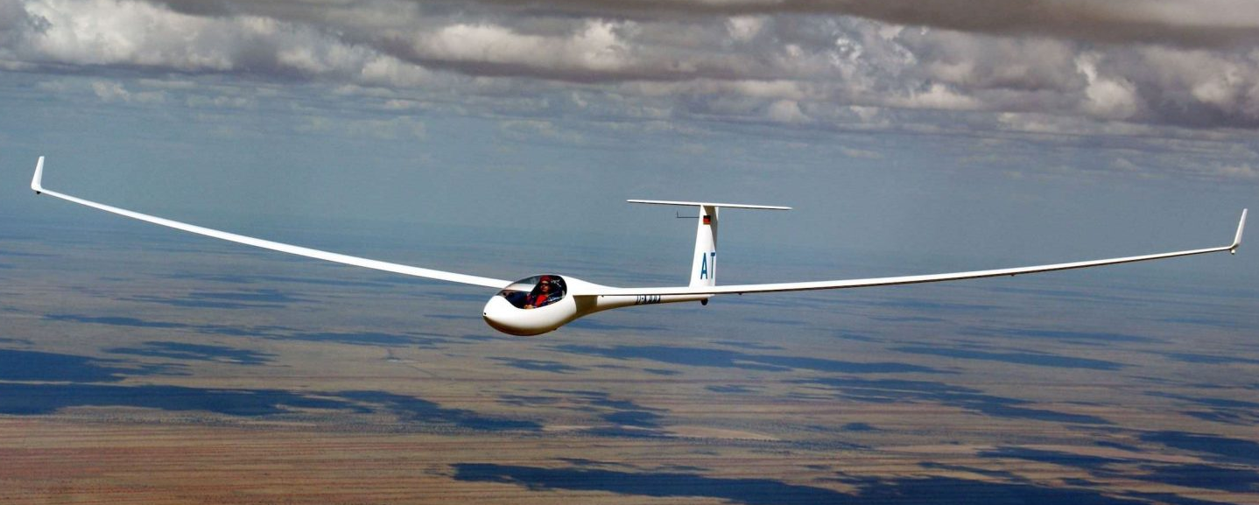
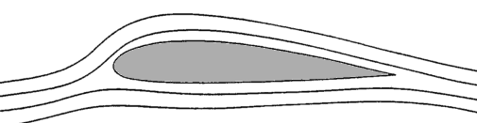
Wing Design
Long, Thin Wings
  Length/Cord ratio >6
  Maximum Lift/Drag in slow flight
Wing Camber
Wing Length
Smooth, Thin Airfoil Shape
  Essential for good gliding performance
Wing Chord

Slide 5
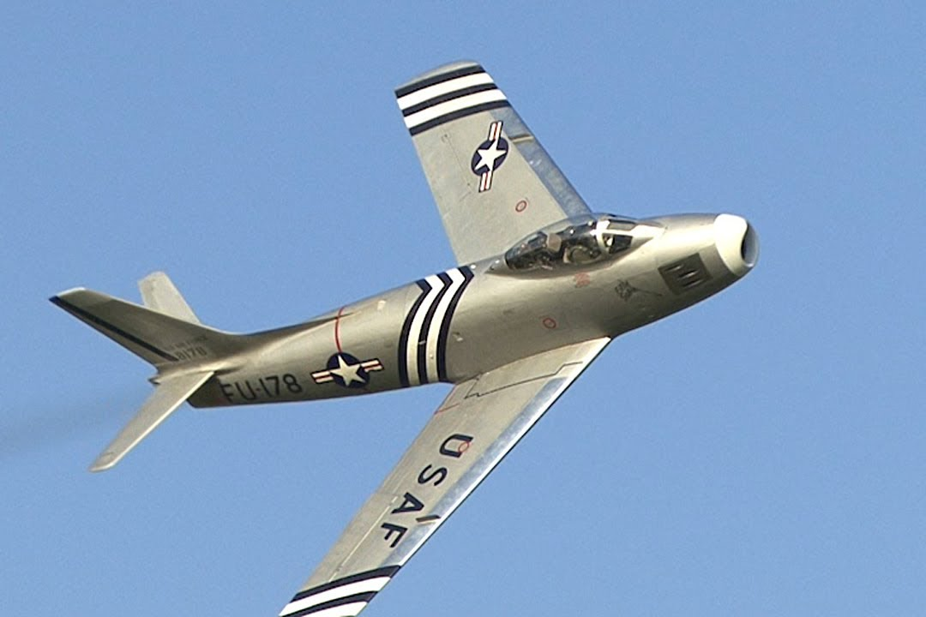
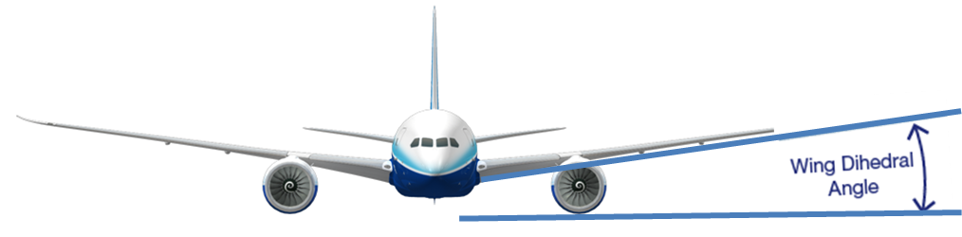
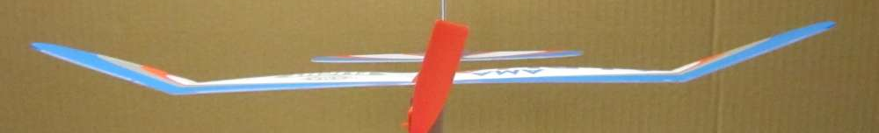
Wing Design
Swept Wings, Bad Idea for Gliders
  Doesn’t help at low speeds
  Makes structure difficult/heavy
Wing Span
Dihedral Angle
  Stabilizes straight forward flight
  Slightly decreases lift
  Can be polyhedral (flat and angled)

Slide 6
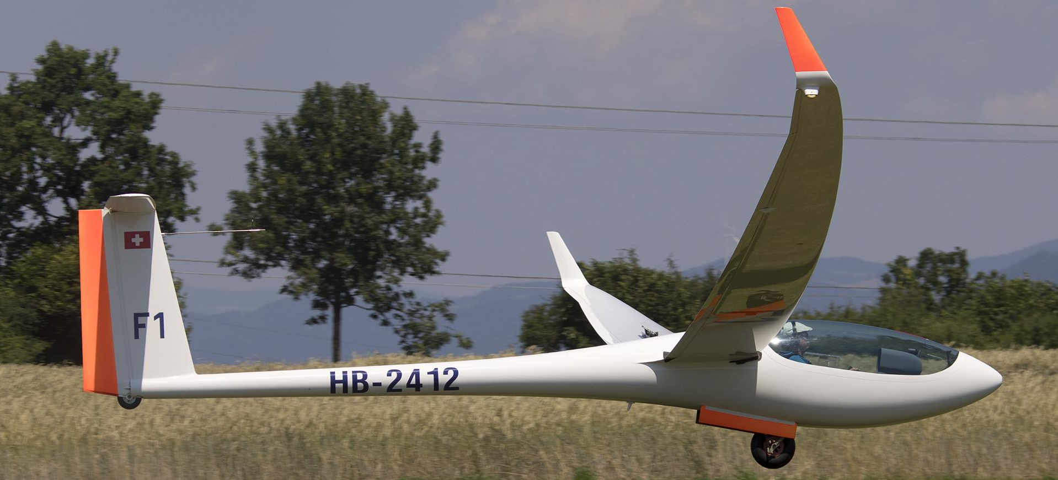
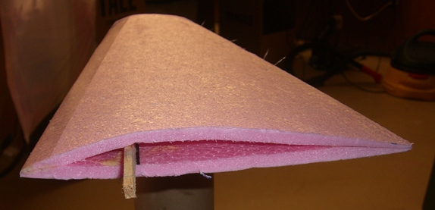
Wing Design
Wing Structure
  Light, but strong design
  The more bend, the less lift
Leading (front) Edge
Example wing structure
  Folded material with spar
Trailing (back) Edge
Spar (structural support)

Slide 7
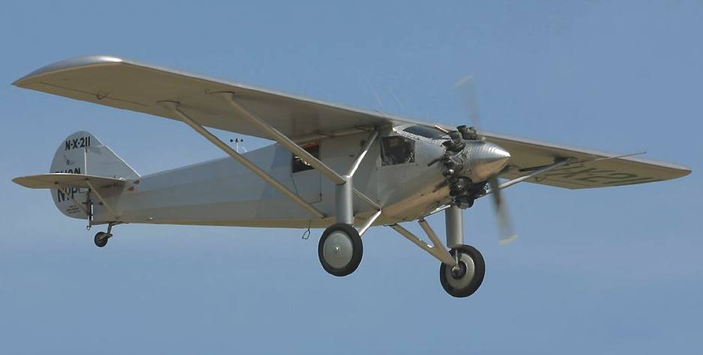
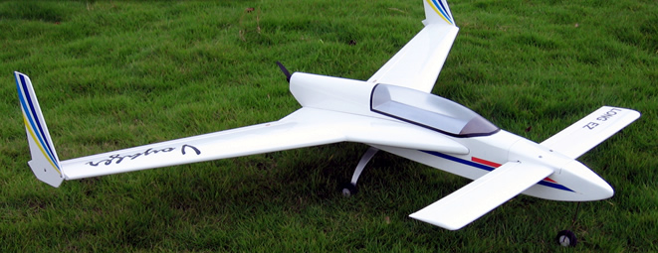
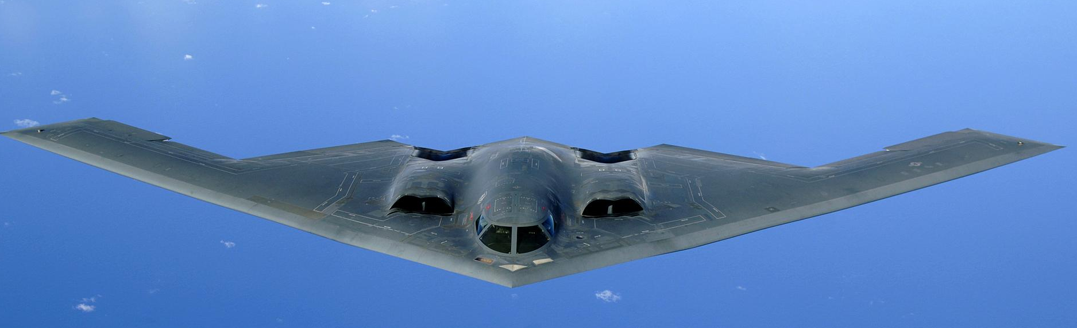
Tail Design
Tail is critical for stability
Horizontal Stabilizer
  At least 1/5 area of wings
Vertical Stabilizer
  At least 1/10 area of wings
Fuselage Length
  4-6x wing chord length
  If too short, won’t be stable
Vertical Stabilizer
Cord Length
Horizontal Stabilizer
Fuselage Length
Canards & Flying Wings
  More efficient
  Almost always unstable

Slide 8
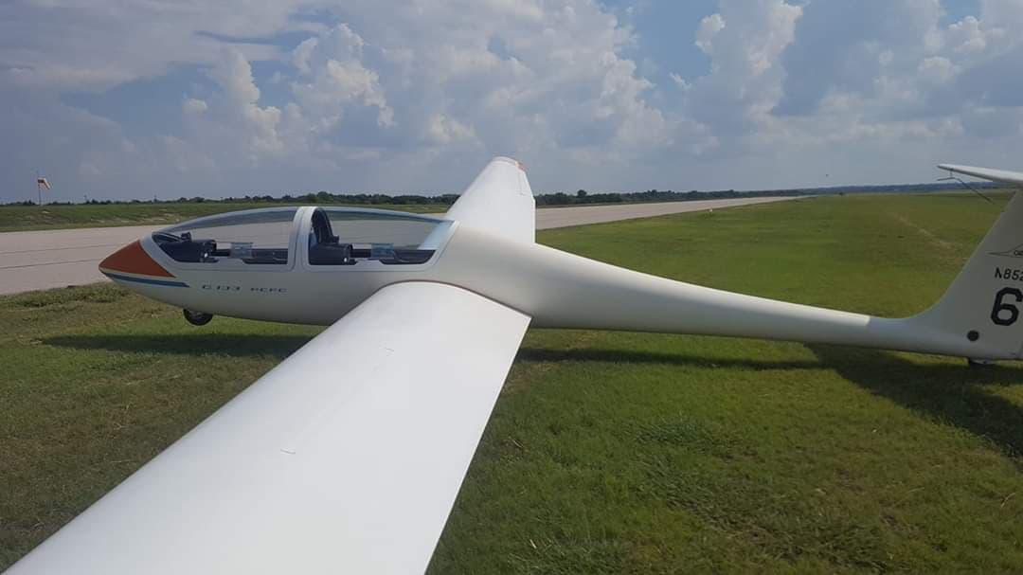
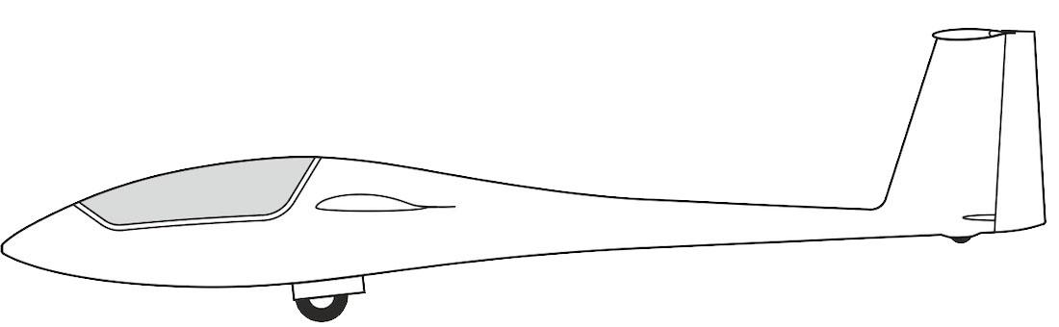
Forces on a glider
Lift
Thrust?
Drag
Lift
Gravity
Drag
Stabilizer Lift
Gravity

Slide 9
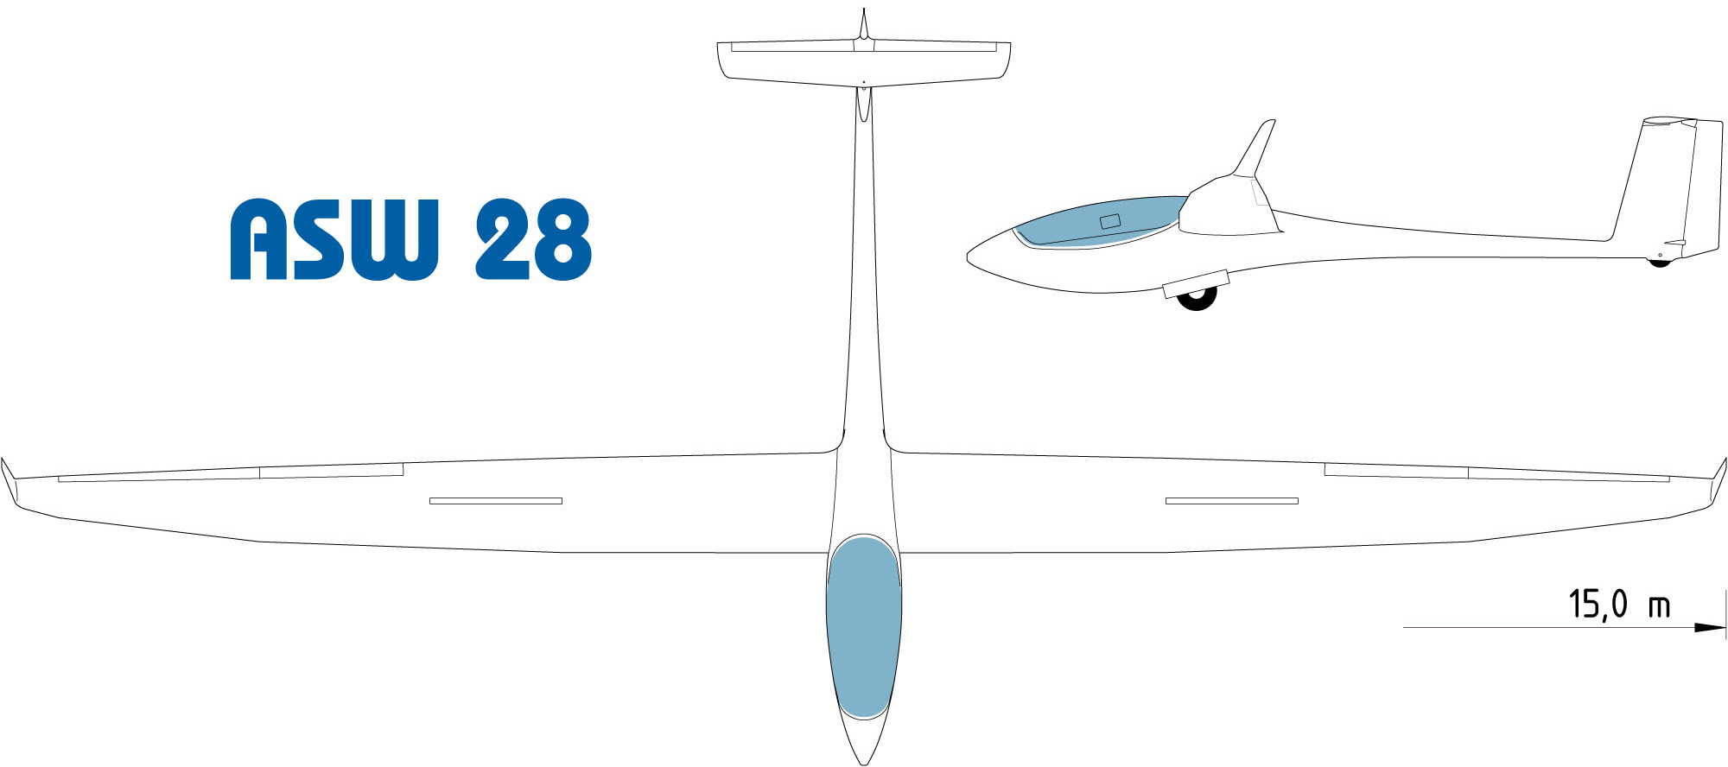
Glider Balance
Most important, Center of Gravity in front of Center of Lift
  Center of Gravity (CG) too far forward flies poorly; CG too far back flies once
Fuselage (Body) length should be close to wing length
Long (3/4 of body length)
Wingspan
Center of Lift ~1/4 chord length
Center of Gravity (balance point)
Short (1/4 of body length)

Slide 10
Design Summary
Long, thin wings. Strong enough to hold up
Tail Surfaces
  Far enough back, big enough to keep the plane stable
  Lightweight
Balance
  CG in front of center of lift

Slide 11
Competition Rules
Minimum 24in Wingspan, no max
Maximum 4x4 Body Width, any length
Must carry 16 marbles in sealed sandwich bag, 2.1oz
Weight between 8oz and 12oz (including marbles)
Total of 4 flights, score is total distance glided
Obstacle, trash can 2ft x 3ft x 1ft at 15 ft.
If glider breaks or hits obstacle, score reduced by 25% for flight
No designs/parts from kits, no metals/hard materials for safety

Slide 12
Suggestions
Hobby/craft stores have balsa wood, foam board, monokote/ultracoat
Balsa wood for leading edge is great
Build a smaller version early to try out design & practice
Don’t waste material/weight on unnecessary things

Slide 13
Wrap-Up
  Good luck!
  Please consider joining AIAA as an educator (https://aiaa.org/membership/types-of-membership/educator-membership/)
  If you have any questions, you can contact me
  chair@aiaacentralflorida.org; 321-945-0786
  or
  Kristine Pionessa, STEM Lead
  stem@aiaacentralflorida.org

